Slide 1
Image Processing and Pattern Recognition (IPPR):
(Lecture 7)

Slide 2
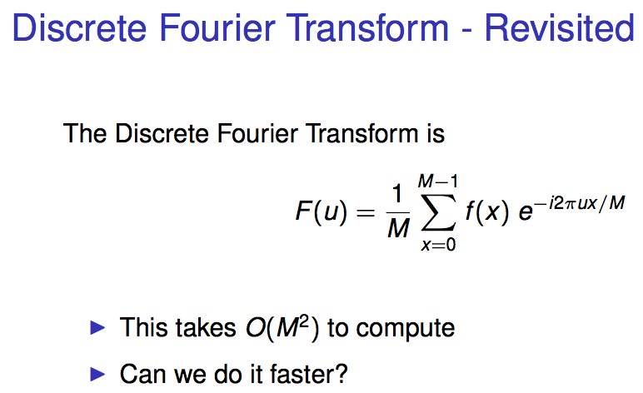
The Fast Fourier Transform (FFT)

Slide 3
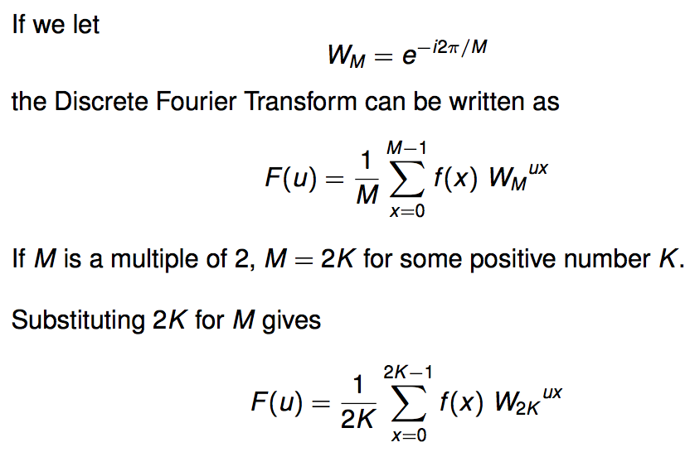
The Fast Fourier Transform (FFT)

Slide 4
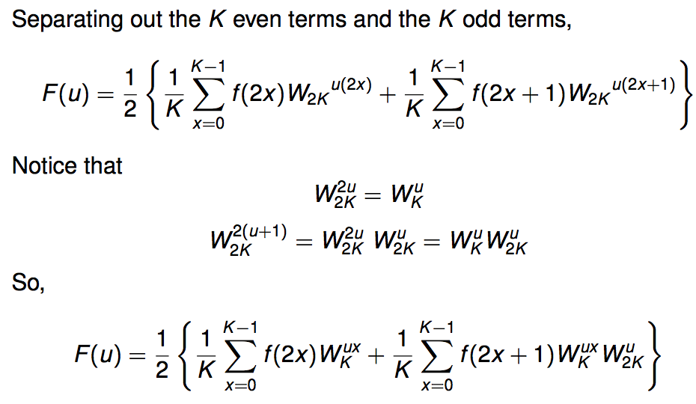
The Fast Fourier Transform (FFT)

Slide 5
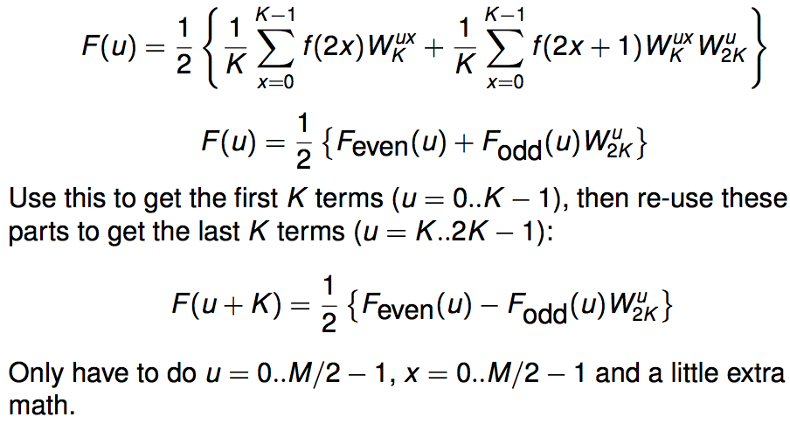
The Fast Fourier Transform (FFT)

Slide 6
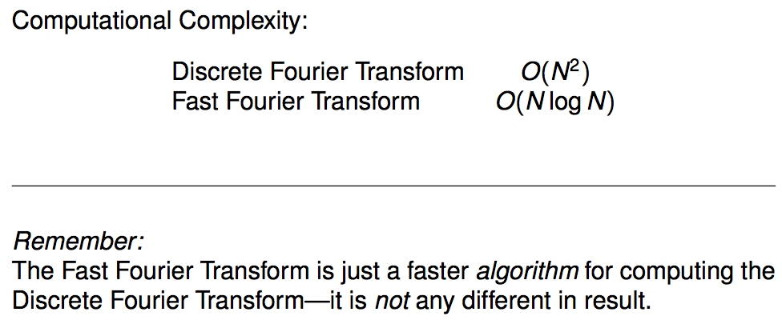
The Fast Fourier Transform (FFT)

Slide 7
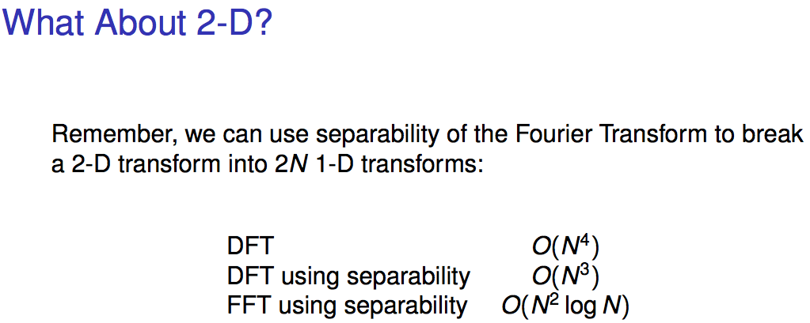
The Fast Fourier Transform (FFT)

